Slide 1

FINAL PROJECT HUMAN COMPUTER INTERACTION
SUBMITTED BY
TAYYABA ZUBAIR-18049
ARIBA WASEEM-18054

Slide 2

What is E-learning?
E-Learning is a learning process with the combination of content delivered digitally and through face-to-face learning. Suited for all levels of education, from grade school to graduate degrees, It is versatile enough to support all learning techniques and has personalized for students, focused on students, and is directly controlled by themselves

Slide 3

GOAL
Improve the interaction between users and application
Making applications more user-friendly and receptive to users’ needs
Provide them with controls, displays, and information elements that keep them interested

Slide 4

MOBILE APPLICATION?
KHAN ACADEMY

Slide 5

PROBLEMS IN EXISTING DESIGN

Slide 6
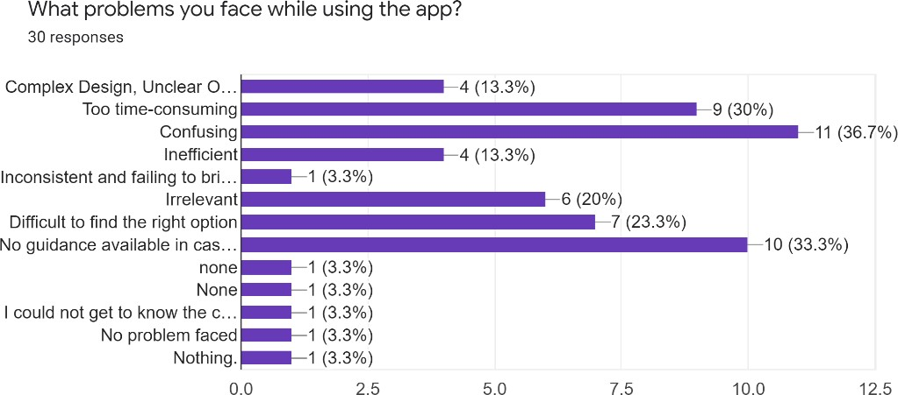
Problems
Time-consuming
Difficult to find the right option
No guidance available
Complex Design
Unclear Options
Confusing

Slide 7
The alignment of objects like buttons, text, icons does not seem like a group.
The text box alignment, page setup does not follow the principle of Similarity
The other rules like Foreground/Background and Combined principles seem scattered throughout the user journey
Inadequacy of affordance and accessibility of app design makes it difficult for users to navigate between features
PROBLEMS

Slide 8

IMPROVED DESIGN

Slide 9
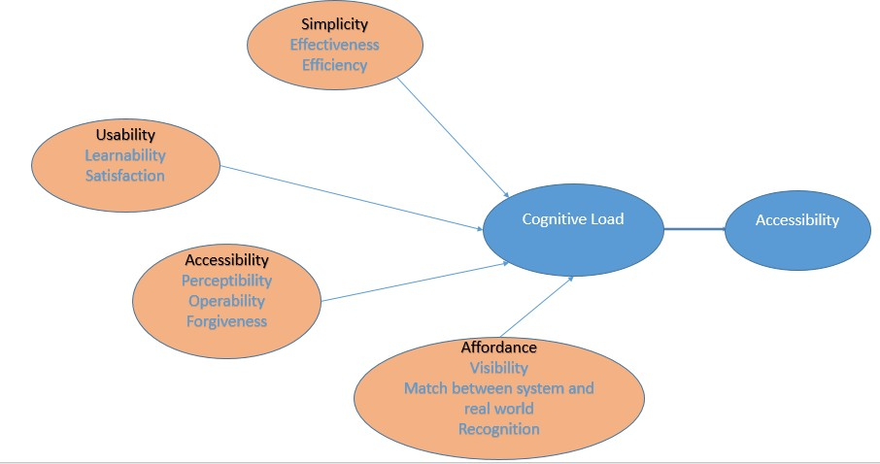
PROPOSED MODEL

Slide 10
Universal Design
The redesign is kept Universal so that all the targeted groups are covered under one umbrella.
The Gestalt Principles and Interaction design methodologies are encompassed to accomplish the universal design
Our proposed models contain the Usability Heuristics such as visibility of system status, Match between the system and real-world, user control, add freedom
The new interface has a minimalist design so that the irrelevant information does not create chaos

Slide 11

DESIGN DEMO

Slide 12
EVALUATION
Usability evaluation needs extra such as:
learner satisfaction with the learning content
learner perception of the applicability of the content
learner enjoyment of the learning experience
actual learning, measured via tests
Following factors are under consideration:
e-learning system feedback
consistency
error prevention
performance/efficiency
user’s like/dislike
error recovery
cognitive load
internationalization
Privacy
online help

Slide 13
EVALUATION
Usability evaluation needs extra such as:
learner satisfaction with the learning content
learner perception of the applicability of the content
learner enjoyment of the learning experience
actual learning, measured via tests
Following factors are under consideration:
e-learning system feedback
consistency
error prevention
performance/efficiency
user’s like/dislike
error recovery
cognitive load
Privacy
online help
internationalization

Slide 14

Evaluation Techniques
Heuristics Evaluation
Cognitive Walkthrough
Think a loud Protocol
Usability Testing Questionnaire

Slide 15

EXPERIMENT

Slide 16

GROUPS
Group A:
Students (Pre-Primary & Primary, college and university students)
Users are already experienced OR already using it
The data was collected from 20 users
Group B:
The Disabled people
Users were Deaf and Mute(Dumb)
The two users were selected for this experiment

Slide 17

GROUP A
Usability Technique: “Usability Testing Questionnaire” and “Think Aloud”
Mode of Experiment: Field study and Laboratory Study
Reason:
To design a good user experience, we need to understand who our users are, what they need, and why.
Usability testing questionnaires help in recognizing data or specific audience requirements.
Since Students are the main stakeholder of E-learning application, They can respond effectively through questionnaire.

Slide 18
GROUP B
Usability Technique: “Cognitive Walkthrough”
Mode of Experiment: Field study
Reason:
CW also focuses on the cognitive activities of users, especially on their goals and knowledge when performing a specific task which is the crucial part of our evaluation.
The main reason to use Cognitive Walkthrough for disabled people is it allows the evaluation of the ease with which a user completes a task with minimal system knowledge and the ease of interface exploration/learning.

Slide 19
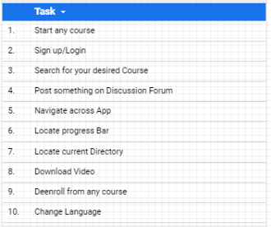
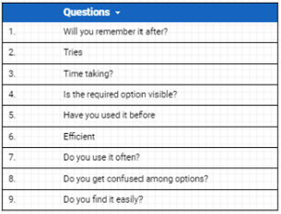
COGNITIVE WALKTHROUGH

Slide 20

ANALYSIS
The parameters which are under study are as follow:
Efficiency
Memorability
Usability
Simplicity
Effortless
Visibility
Affordance
Accessibility

Slide 21
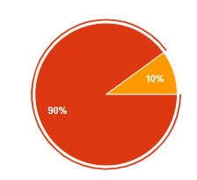
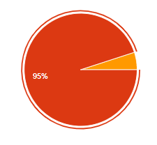
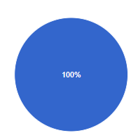
SIMPLICITY AND CONSISTENCY
IMPROVEMENTS:
we used "Strive for consistency”, we used consistent graphics such as fonts, color, shapes, etc. And make sure that they would do the same thing the same way they have been doing. we took the help of “Hicks Law” and did not provide extra choices so that usability can be improved.
FEEDBACK:
around 90% of users believe that the design is consistent and straightforward
95% of them do not need extra tutorials or guidance to use the app
100% find it consistent.

Slide 22
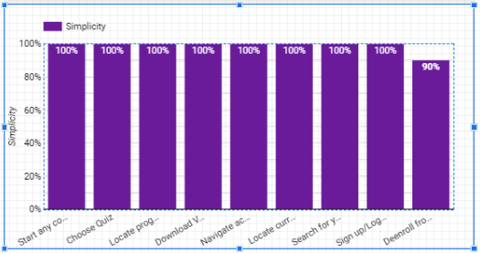
Consistency and Simplicity with Cognitive Walkthrough

Slide 23

CATER TO UNIVERSAL USABLITY
Due to simplicity and additional features, the application can cater to a wide range of users, such as primary, pre-primary, and university students. Additionally, we have introduced the elements of script and notes below the lecture video, which cater to people who have a disability of deafness.

Slide 24
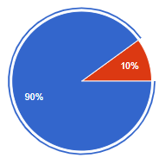
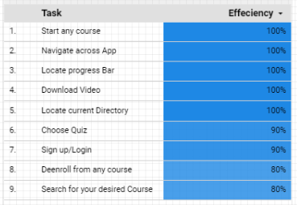
INFORMATIVE FEEDBACK
IMPROVEMENTS:
now our design provides the users' feedback, which tells them that they are proceeding in the right direction, decreasing the chances of errors and increasing efficiency and user experience.
FEEDBACK:
90% of our users found the feedback informative in our proposed design.
100% of users can quickly locate the progress bar, which is helping them to know their pace of learning

Slide 25
There are other design rules, which we implement in our design that are:
Through the implementation of simplicity, the short-term memory load gets decreased which in turn prevent errors
We provide the help and feedback option, if in case user needs it, and design dialogues for closures to make user feel better

Slide 26
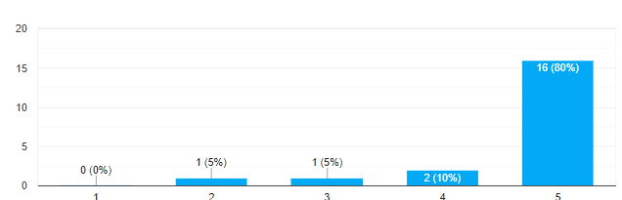
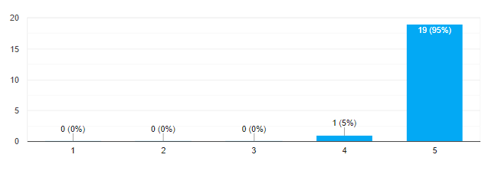
OVERALL FEEDBACK
Satisfaction from Design, process and structure
Satisfaction from integration of function

Slide 27
LIMITATIONS
The app does not redirect the user to the last activity in some of the cases.
The Unauthorized User can’t View his progress while accessing the course material.
Only download material can be accessed in an offline mode.
The app has limited languages available.
While accessing the Special mode, the user should know about reading the course content.

Slide 28

FUTURE WORK
The study will likewise be directed on various groups of users who have different backgrounds. Besides, a more upgraded version of the design would be made so that the user experience can be improved more

Slide 29

THANK YOU

